Slide 1

Aphrodite
Ἀφροδίτη
Presenters: Sophia & Emily

Slide 2
1.Origin

Slide 3
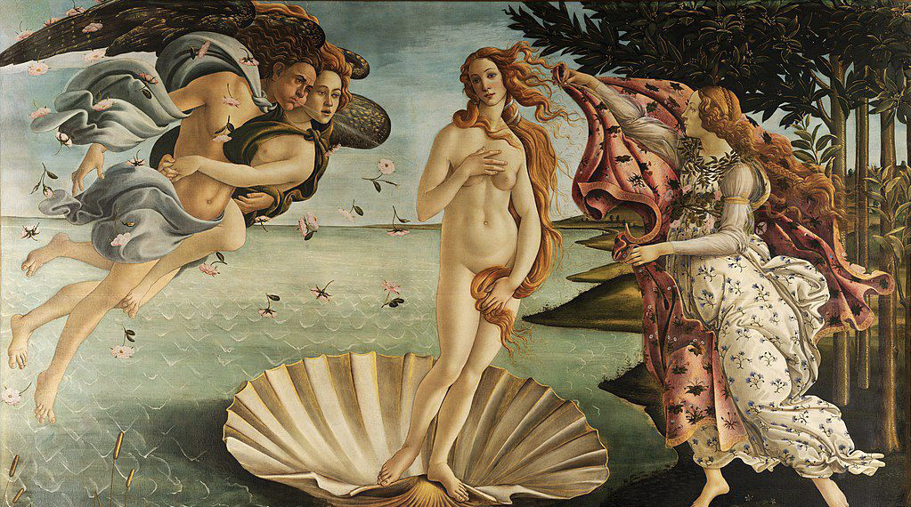
There are two versions about the birth of Aphrodite. One is that Cronus castrated his father, the god Uranus, and then, to avoid any trouble caused by his behavior, threw Uranus' genital into the Aegean sea. When Uranus was castrated by Cronus, his blood dripped into the sea and Aphrodite was born. "Aphrodite," which means "born out of the foam of the sea. Another is that he was born of Zeus and Dione.

Slide 4
2.Stories

Slide 5

The Oceanid got married, but did not invite Eris, Eris was very angry. In retaliation, she placed a golden apple in one place with the words, "to the most beautiful goddess." Hera, Athena and Aphrodite, who attended the wedding, contended that they were the most beautiful. Zeus then sent Paris, prince of Troy, to decide. To obtain the golden apple, three goddesses promised Paris authority, honor and beauty respectively. Paris finally fell in love with the beauty promised by Aphrodite, then he gave the golden apple to Aphrodite, and with her help lured away Sparta king Menelaus’s wife, beauty Helen, thus leading to the outbreak of the Trojan war.

Slide 6
3.Worshipping Land and Symbolism

Slide 7
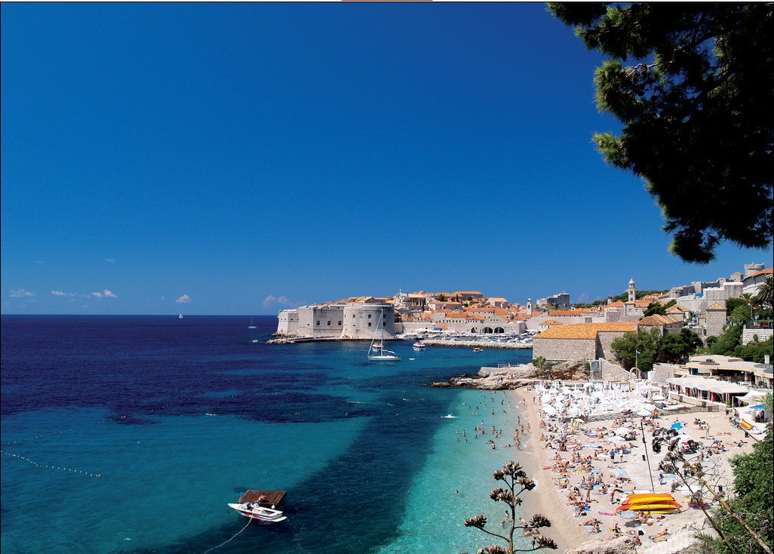
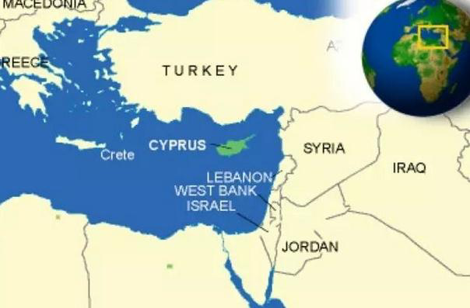
Worshipping Land
Cyprus

Slide 8
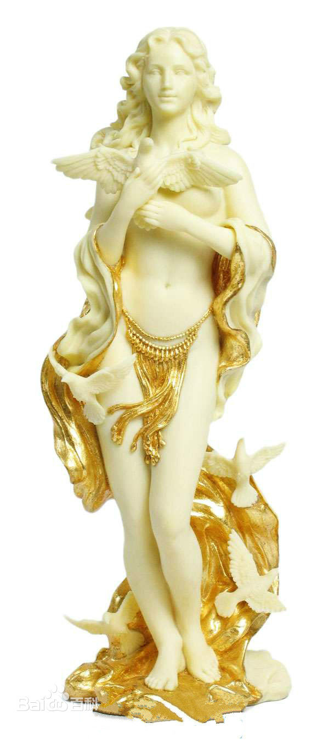
Symbolism
The goddess of the harvest
The goddess of sea
The goddess of love and marriage
The goddess of beauty

Slide 9
4.Three Treasures of louvre

Slide 10
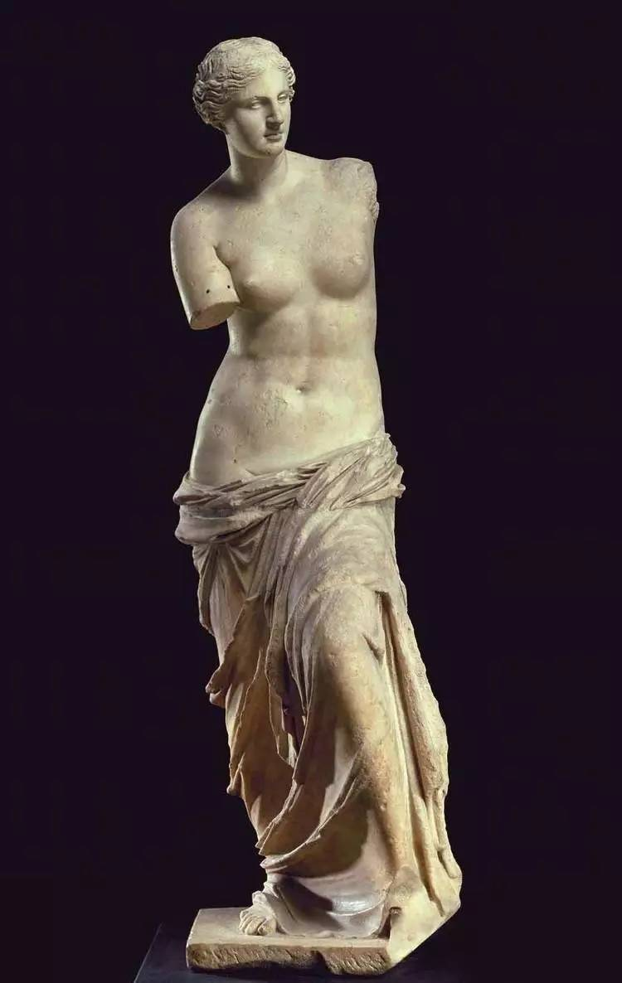
Venus de milo
WHEN
WHERW
4th century BC
ancient Greek
WHO
Alexandros of antioch

Slide 11
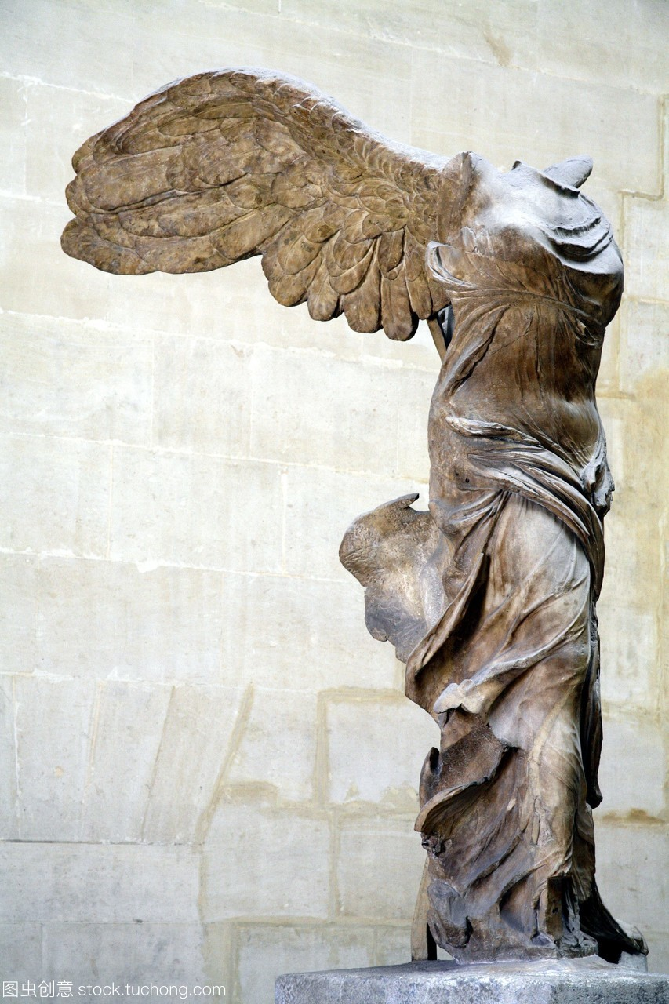
The statues Victory of Samothrace

Slide 12
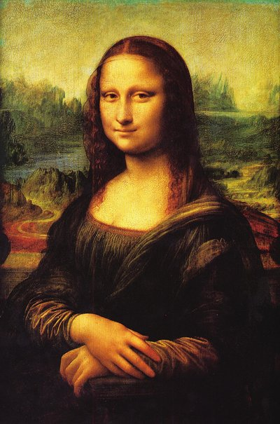
The Mona Lisa
---leonardo da vinci

Slide 13
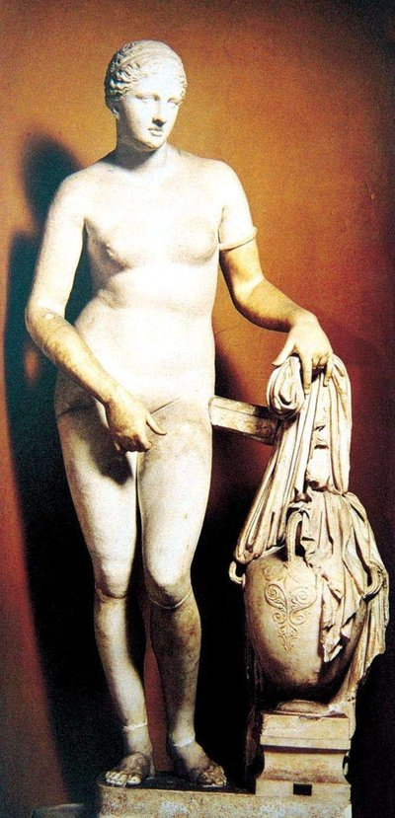
Venus of Cnidus
The earliest nude statue of venus
Vatican museum

Slide 14
Thank you

